Slide 1
CASE STUDY -CNN

Slide 2
History of LeNet-5 LeNet-5 (1998)
LeNet-5 was one among the earliest convolutional neural networks which promoted the event of deep learning.
After innumerous years of analysis and plenty of compelling iterations, the end result was named LeNet-5 in 1988.
In 1989, Yann LeCun et al. at Bell Labs initially applied the backpropagation rule to all sensible applications, and believed that the flexibility that is provided in network generalization can be increased dramatically by providing constraints from the tasks domain.

Slide 3
Objective
Transfer learning through Pre-trained models is a time and cost-efficient solution for deep learning problems.
Understand the Architecture of Lenet-5 as proposed by the authors.
Transfer learning works in a similar manner. Transfer learning is the method that uses a neural network trained on a large and generalized enough dataset and being used for another problem. These neural networks are called Pre-trained networks.

Slide 4
Features of LeNet-5
Every convolutional layer includes three parts: convolution, pooling, and nonlinear activation functions
Using convolution to extract spatial features (Convolution was called receptive fields originally)
Subsampling average pooling layer
tanh activation function
Using MLP as the last classifier

Slide 5
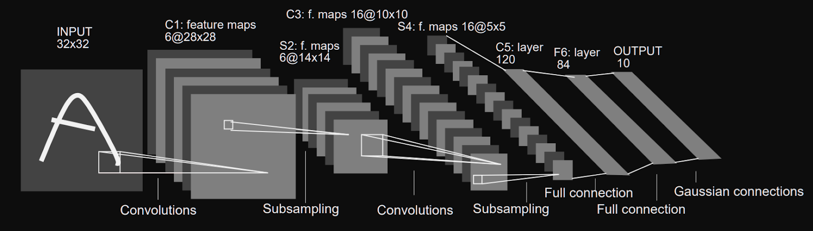
Architecture of LeNet-5

Slide 6
Layer1:The input for LeNet-5 is a 32×32 grayscale image which passes through the first convolutional layer with 6 feature maps or filters having size 5×5 and a stride of one. The image dimensions changes from 32x32x1 to 28x28x6.
Layer2:Then the LeNet-5 applies average pooling layer or sub-sampling layer with a filter size 2×2 and a stride of two. The resulting image dimensions will be reduced to 14x14x6.
Layer3:Next, there is a second convolutional layer with 16 feature maps having size 5×5 and a stride of 1. In this layer, only 10 out of 16 feature maps are connected to 6 feature maps of the previous layer as shown below.Output reduced to 10x10x16

Slide 7
Layer4:The fourth layer (S4) is again an average pooling layer with filter size 2×2 and a stride of 2. This layer is the same as the second layer (S2) except it has 16 feature maps so the output will be reduced to 5x5x16.
Layer5: The fifth layer (C5) is a fully connected convolutional layer with 120 feature maps each of size 1×1. Each of the 120 units in C5 is connected to all the 400 nodes (5x5x16) in the fourth layer S4.
Layer6: The sixth layer is a fully connected layer (F6) with 84 units.
Layer7:Finally, there is a fully connected softmax output layer ŷ with 10 possible values corresponding to the digits from 0 to 9.

Slide 8
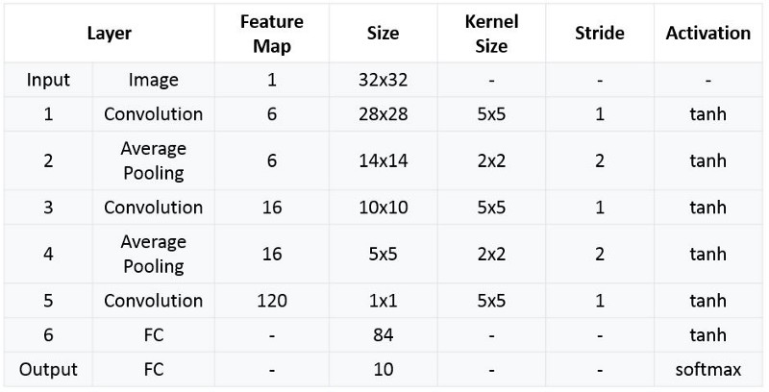

Slide 9
AlexNet AlexNet (2012)
AlexNet was primarily designed by Alex Krizhevsky.
AlexNet, which employed an 8-layer CNN.
Alexnet has 8 layers. The first 5 are convolutional and the last 3 are fully connected layers. In between we also have some ‘layers’ called pooling and activation.

Slide 10
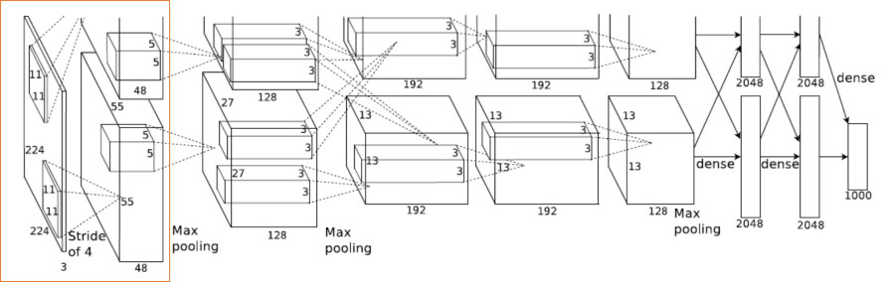
Architecture:

Slide 11
Layer1
Layer 1 is a Convolution Layer,
Input Image size is – 224 x 224 x 3
Number of filters – 96
Filter size – 11 x 11 x 3
Stride – 4
Layer 1 Output
224/4 x 224/4 x 96 = 55 x 55 x 96 (because of stride 4)
Split across 2 GPUs – So 55 x 55 x 48 for each GPU

Slide 12
Layer 2
Layer 2 is a Max Pooling Followed by Convolution
Input – 55 x 55 x 96
Max pooling – 55/2 x 55/2 x 96 = 27 x 27 x 96
Number of filters – 256
Filter size – 5 x 5 x 48
Layer 2 Output
27 x 27 x 256
Split across 2 GPUs – So 27 x 27 x 128 for each GPU
Layers 3, 4 & 5 follow on similar lines.

Slide 13
Layer 6 is fully connected
Input – 13 x 13 x 128 – > is transformed into a vector
And multiplied with a matrix of the following dim – (13 x 13 x 128) x 2048
GEMV(General Matrix Vector Multiply) is used here:
Vector X = 1 x (13x13x128)
Matrix A = (13x13x128) x 2048 – This is an external input to the network
Output is – 1 x 2048
**Layers 7 & 8 follow on similar lines.

Slide 14
VGGNet-16
VGGNet-16 consists of 16 convolutional layers and is very appealing because of its very uniform Architecture.
Similar to AlexNet, it has only 3x3 convolutions, but lots of filters.
It can be trained on 4 GPUs for 2–3 weeks.
It is currently the most preferred choice in the community for extracting features from images.
The weight configuration of the VGGNet is publicly available and has been used in many other applications and challenges as a baseline feature extractor.

Slide 15
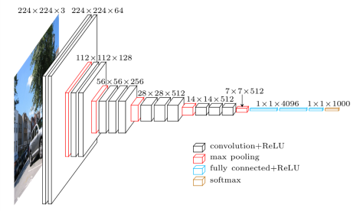
Architecture

Slide 16
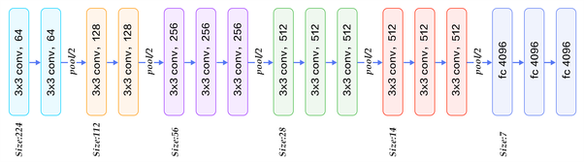

Slide 17
16 layers
1.Convolution using 64 filters 2.Convolution using 64 filters + Max pooling 3.Convolution using 128 filters 4. Convolution using 128 filters + Max pooling 5. Convolution using 256 filters 6. Convolution using 256 filters 7. Convolution using 256 filters + Max pooling 8. Convolution using 512 filters 9. Convolution using 512 filters 10. Convolution using 512 filters+Max pooling 11. Convolution using 512 filters 12. Convolution using 512 filters 13. Convolution using 512 filters+Max pooling 14. Fully connected with 4096 nodes 15. Fully connected with 4096 nodes 16. Output layer with Softmax activation with 1000 nodes.

